Slide 1
Master Thesis
Parallel in Time methods: supercomputing algorithms and efficient implementation of particle methods

Slide 2
Parallel in Time methods
Iterative or direct
Types:
Multiple shooting
Parareal
Domain decomposition/waveform relaxation
Multigrid
PFASST

Slide 3


Multiple shooting
Split time domain in chunks
Find rough approximation at each intersection in serial -> start and endpoint for trajectories
Find trajectory in each chunk in parallel and piece together
Calculate fine trajectories for different starting points in neighborhood in parallel
Piece together solution by interpolating the closest trajectories in the next chunk

Slide 4
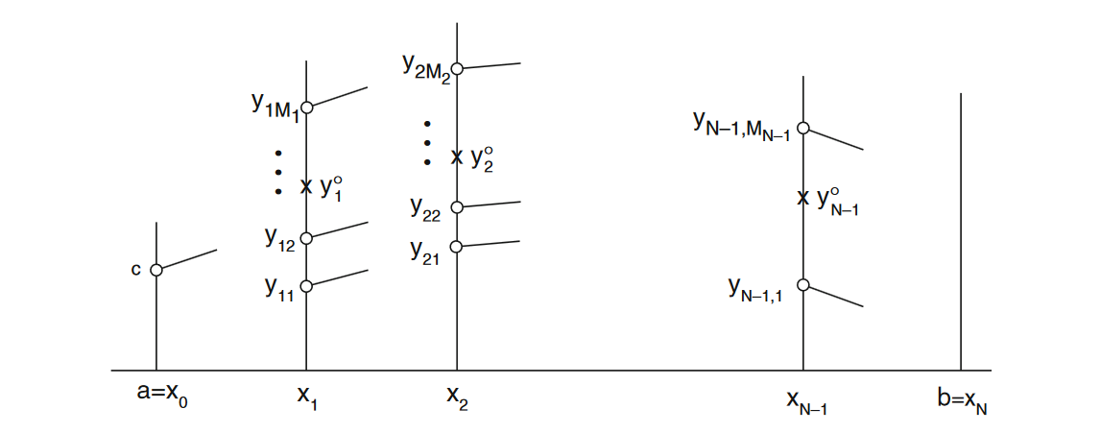
Nievergelt 1964
Split time domain in chunks
Rough forward euler in serial-> start and endpoint for trajectories
Calculate fine trajectories for different starting points in neighborhood of intersection in parallel
Piece together solution by interpolating the closest trajectories in the next chunk

Slide 5
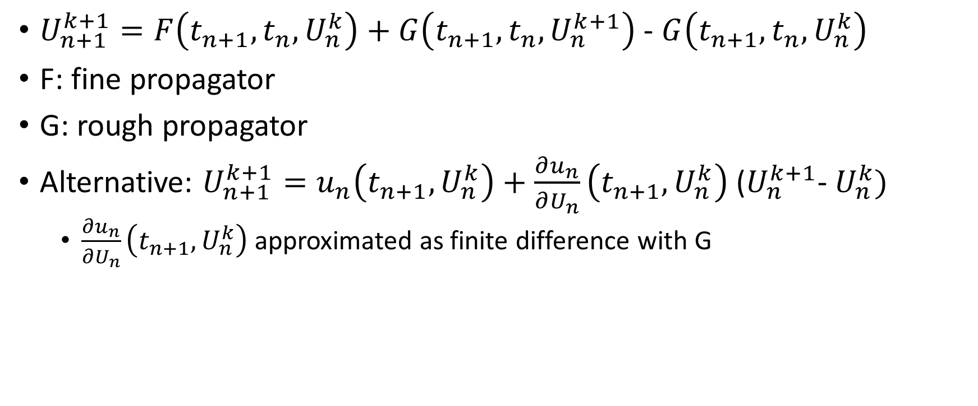
Parareal
$U_{n+1}^{k+1}=F\left(t_{n+1},t_{n}, U_{n}^{k}\right)+G\left(t_{n+1},t_{n}, U_{n}^{k+1}\right)$ - $G\left(t_{n+1},t_{n}, U_{n}^{k}\right)$
F: fine propagator
G: rough propagator
Alternative: $U_{n+1}^{k+1}=u_{n}\left(t_{n+1}, U_{n}^{k}\right)+\frac{∂u_{n}}{∂U_{n}}\left(t_{n+1}, U_{n}^{k}\right)$ ($U_{n}^{k+1}$- $U_{n}^{k})$
$\frac{∂u_{n}}{∂U_{n}}\left(t_{n+1}, U_{n}^{k}\right)$ approximated as finite difference with G

Slide 6
Domain decomposition
Split range of DE
Multiple DE’s across the space domain
Solve DE’s iteratively at the same time and exchange information at the intersections between iterations
Best with overlap of domains

Slide 7
Multigrid
Simultaneously on entire space-time domain
Start on fine grid
Smoother (solves system in a way that the error is smooth)
Restriction to coarse grid (possible to recursively solve smoother)
Solve for residual and error
Interpolate to finer grid and add to original solution

Slide 8
PFASST
3 components:
Spectral deferred corrections
Parareal/SDC hybrid
FAS

Slide 9
Spectral deferred corrections
Insert extra interpolation points in each time interval and solve ode
Fit polynomial through the points
Find residual (difference between actual polynomial and how the ode describes it)
Find Error (difference between actual solution and polynomial)
Add error to found ode solution and repeat
-> Order of method = min(degree of polynomial interpolation, iterations)

Slide 10
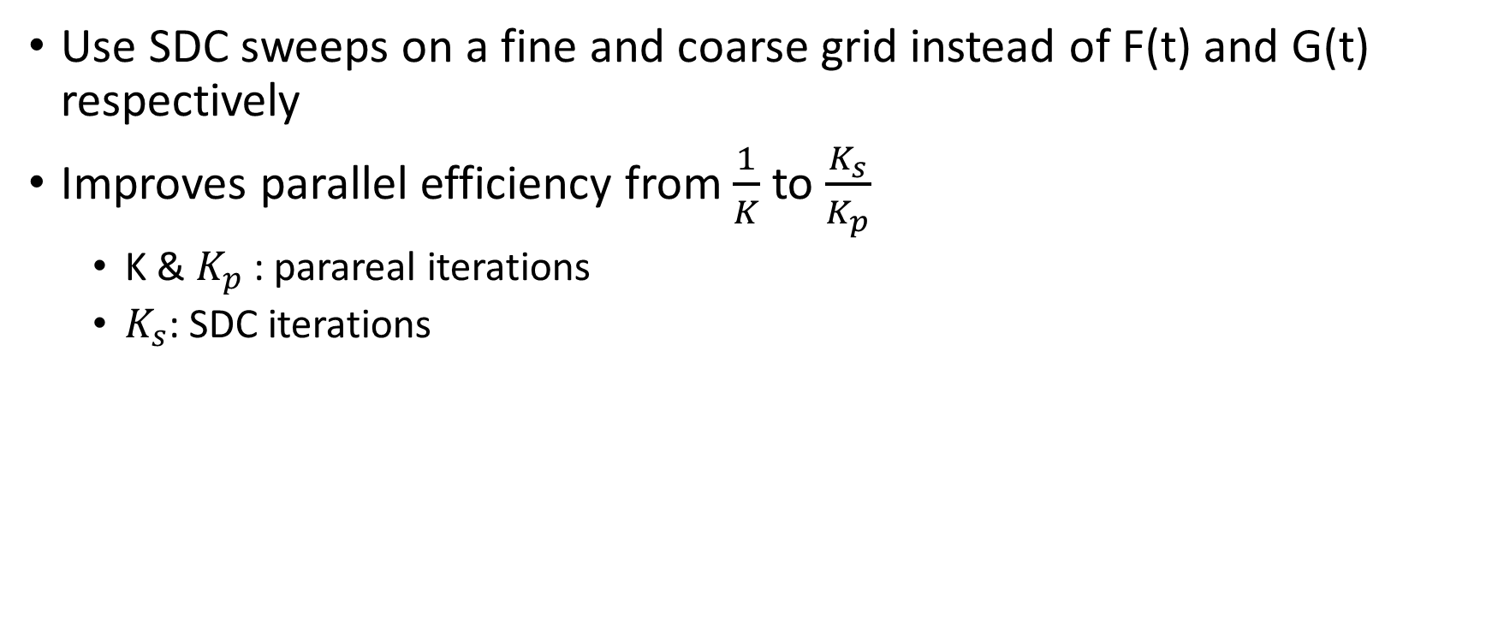
Parareal/SDC hybrid
Use SDC sweeps on a fine and coarse grid instead of F(t) and G(t) respectively
Improves parallel efficiency from $\frac{1}{K}$to $\frac{K_{s}}{K_{p}}$
K & $K_{p}$: parareal iterations
$K_{s}$: SDC iterations

Slide 11
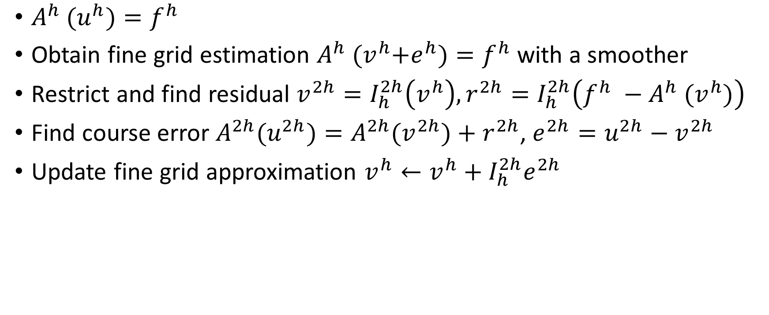
FAS
$A^{h}$ ${(u}^{h})=f^{h}$
Obtain fine grid estimation $A^{h}$ ${(v}^{h}+e^{h})=f^{h}$ with a smoother
Restrict and find residual $v^{2h}=I_{h}^{2h}\left(v^{h}\right), r^{2h}=I_{h}^{2h}\left(f^{h} −A^{h} {(v}^{h})\right)$
Find course error ${A^{2h}(u}^{2h})={A^{2h}(v}^{2h})+r^{2h}$, $e^{2h}=u^{2h}−v^{2h}$
Update fine grid approximation $v^{h}←v^{h}+I_{h}^{2h}e^{2h}$

Slide 12
Approximate Time-parallel method
Temporal multiscale hybridization method based on a time parallel equation
Works with coarse and fine propagator
Uses gradient descent to minimize total error
Approximates correction on coarse solution via (hopefully known analytically) interpolation
Base algorithm not parallel, but should be possible

